Slide 2

Welcome to Hazel

Slide 3
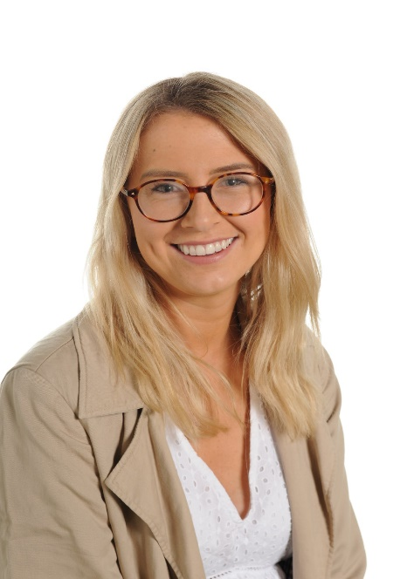
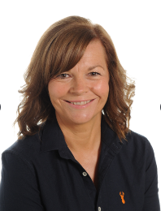
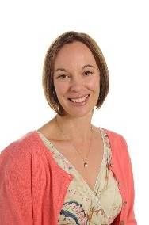
Meet The Team
Miss Kelly
Class Teacher
Mrs Williams
PPA Cover
Tuesday Afternoons
Mrs Parker
Teaching Assistant
Every Morning & Monday PM

Slide 4
Routine

Slide 5
Routine
Tuesday & Friday - PE
Thursday- Spellings
Friday- Reading 1:1
Mornings- Outdoor Learning
Afternoon Assemblies

Slide 6
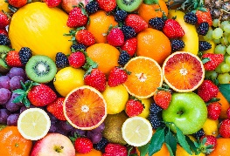
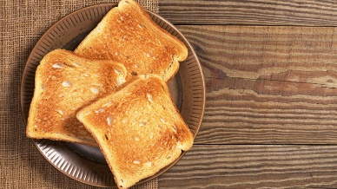

Playtime and Lunchtime
Morning Playtime 10:30- 10:45
Children have the choice of a healthy snack or toast and milk if paid for in advance.
Lunchtime 12:15- 1:15
Children go into the hall at 12:15 and eat either packed lunch or hot dinner.
When they finish eating, they go outside and play until 1:15.
Afternoons:
Children are offered fruit.

Slide 7

Mental Health and Wellbeing
Golden Thread
Large focus in term 1
Zones of Regulation
Metacognition- learning to learn
Mindfulness
Mental Health Ambassadors
Hello Yellow- watch this space!

Slide 8

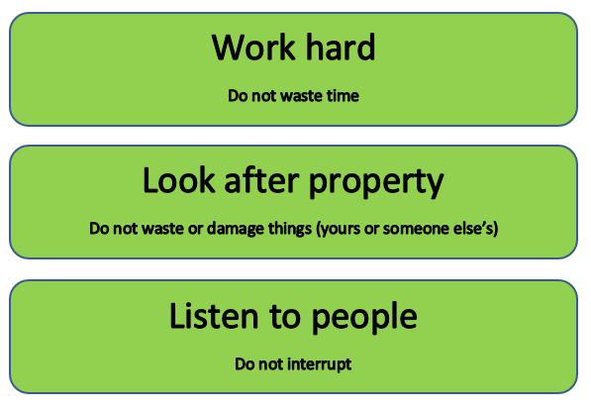
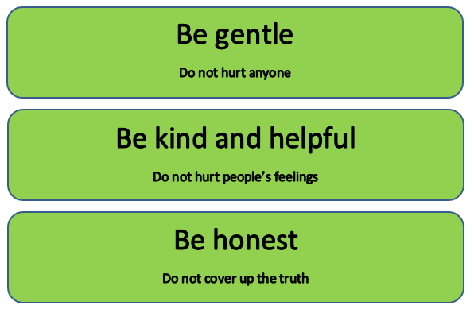
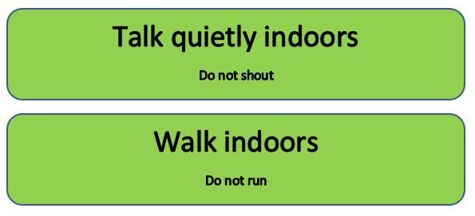
Rules and Expectations
Exceptional behaviour (text sent home)
Behaviour Chart
Shown good behaviour all day
Shown some good behaviour
Well behaved
Verbal warning
2 minutes reflection time
5 minutes reflection time
(text sent home)

Slide 9
Values and Threads
Values:
Ambition
Mindfulness
Honesty
Resilience
Compassion
Thankfulness
Respect
Curiosity
Golden Threads:
Community
Mental Health
Life Skills
Global Issues
Technology

Slide 10





Teaching and Learning
Children need to learn how to learn!
We will be continuing to encourage the children to develop the following skills:
Owl
Strategic Planning
Spider
Links in Learning
Chameleon
Changing Learning
Bee
Team Work
Cat
Curiosity and
Questioning
Unicorn
Creativity
Tortoise
Resilience

Slide 11
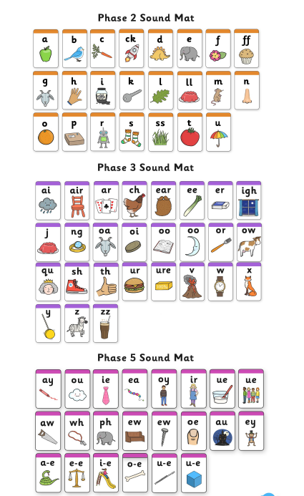

Reading
In school:
1:1 reading with an adult weekly (or more if we feel your child needs extra support)
Daily Phonics Lesson
Focusing on new sounds and
Common Exception Words.
Guided reading
VIPERS
Focus on comprehension skills alongside phonics to develop their fluency.

Slide 12

Reading/Spelling
At home:
Every child should be reading a school reading book at least 3-5 times a week at home
Practising their spellings weekly (these will be checked on a Thursday and updated on a Friday).
Coloured Book Bands
Your child will have 2 books on the colour they are reading.
These books can be changed on a Friday and I would suggest they are read twice before being changed.

Slide 13
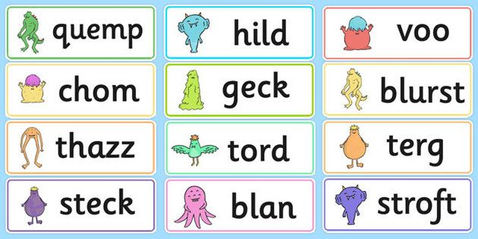
Year 1 Phonics Screening Check
This will take place in June 2022
It is Teacher led and completed 1:1
Each child will read 40 words (a mixture of real and nonsense words) from a booklet.
This is a short, light touch assessment to confirm whether individual children have learnt phonic decoding to a standard.
It will identify the children who need extra help to improve reading skills.

Slide 14


Maths
At home:
Number Bonds and Counting in 2s, 5s and 10s.
Practise 3-5 times a week.
This can be on Numbots, TT Rockstars or on paper either with an adult/seen by an adult.
Activity must be recorded in home learning record.
This will support their fluency in maths learning at home and give them an extra hour of learning time every week for maths.

Slide 15
Topics
Term 1: What makes me Super?
Term 2: How did Dinosaurs become Extinct?
Term 3: What Toys did children play with in the past?
Term 4: Which Planet do we live on?
Term 5: How does your garden grow?
Term 6: Where in the world is Africa?

Slide 16
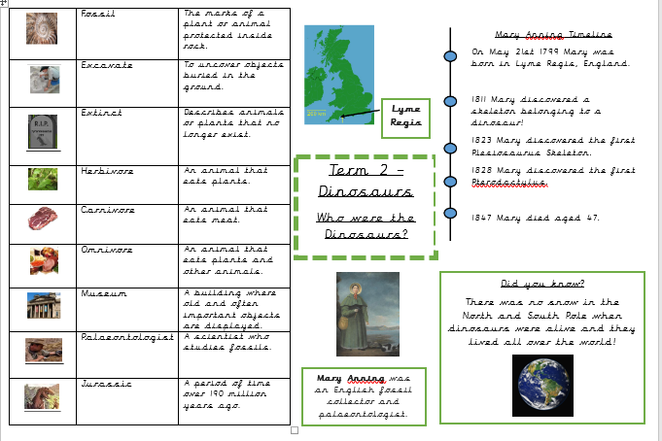
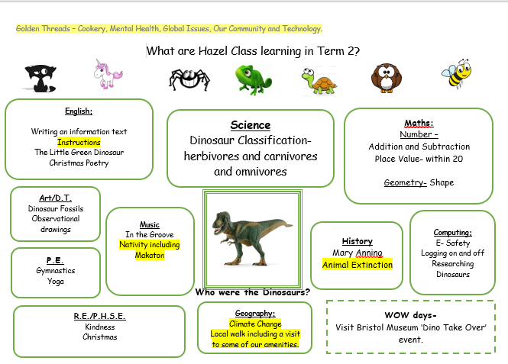
Curriculum Maps and Knowledge Organiser

Slide 17
Coming up:
Sparkle Mufti Day 1st October
Hello Yellow 8th October
School Photographs 13th October
Superhero Dress up Day Monday 18th October
Progress Checkers
Parents Evening
Term 2 & 3 Mystery Reader – Wednesday at 3pm
Volunteers

Slide 18


Thank you for listening!
Don’t forget to follow us on Twitter.
@HazelClass_RE
enquiries@redfieldedgeprimary.co.uk

Slide 19

Questions

