Slide 1

Welcome to Pine

Slide 2
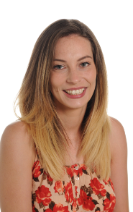
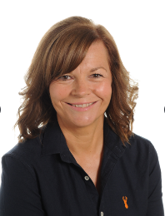
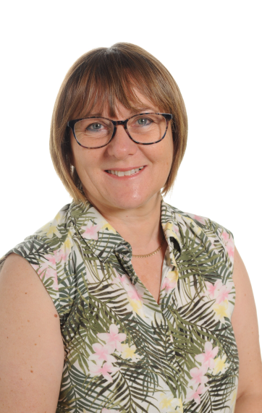
Meet The Team
Miss Andrews
Class Teacher
Mrs Williams
HLTA Teaching Assistant
Tuesday and Wednesday
Mornings
Mrs Sheppard
HLTA Teaching Assistant
Tuesday Afternoon

Slide 3
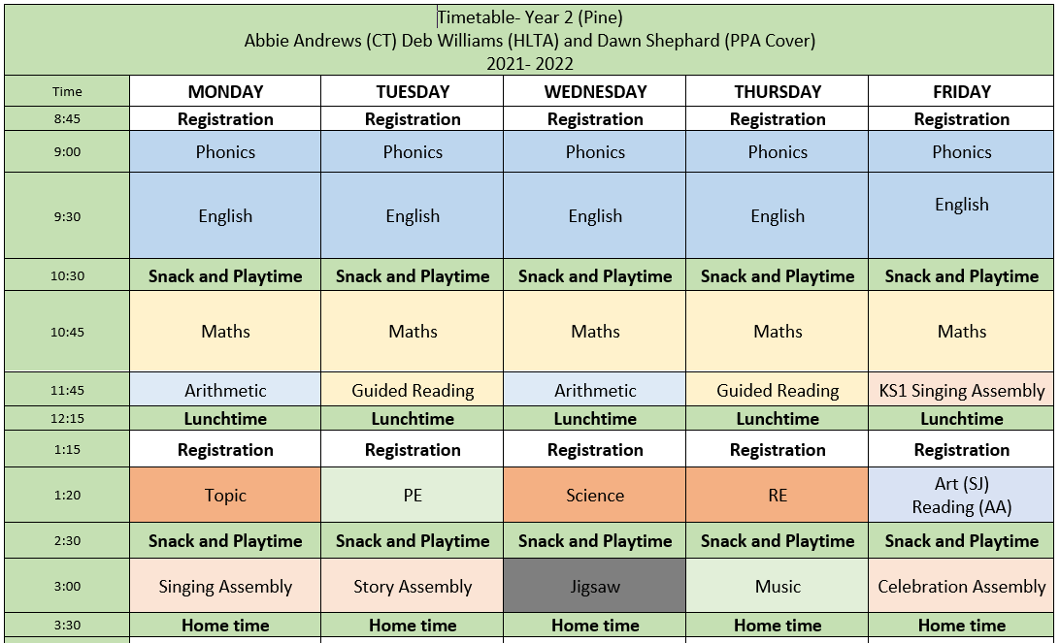
Routine
Tuesday- PE
Thursday- Maths 3 star awards tested
Friday- Reading and Maths Homework checked

Slide 4

Guided Reading

Slide 5
Reading
In school:
Guided reading
VIPERS (please see handout attached)
Focus on comprehension skills gearing up to Reading SATs paper
Library and Reading for Pleasure
The children read independently in class every day as well as listening to our class book read aloud.
They are also given the opportunity to change their book at least once a week in the library.
Reading Assistant
A select few children will be listened to. These are children who need extra support in reading comprehension.

Slide 6
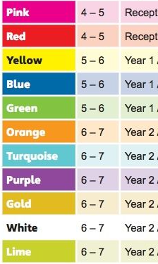
Reading
At home:
Every child should be reading a school reading book at least 5 times a week at home
Coloured Book Bands
Your child will have 2 books on the colour they are reading.
These books can be changed at any point in the week but I suggest children read the book at least twice before changing.
They are also allowed to read books from home and this can be recorded in their Reading Record Book.
If they read 5 times they move along the reading train.

Slide 7
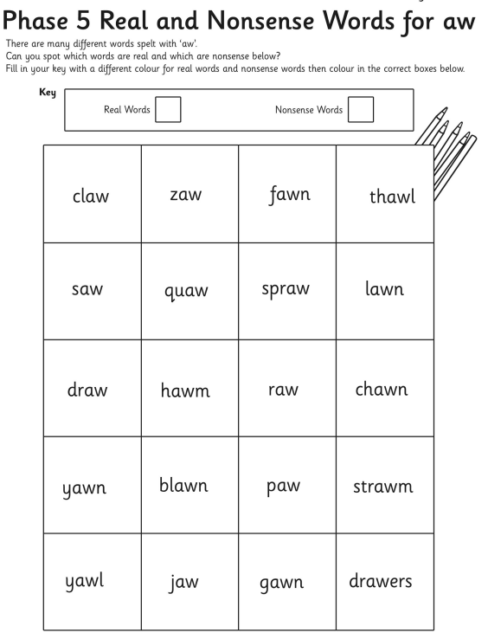
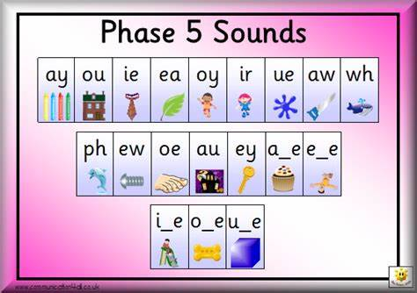
Phonics and Tricky Words
Tricky Words will no longer be expected to do at home. Spellings will start to come home and children will be tested on a Friday.
Phonics Screening will take place in Term 2 due to COVID.

Slide 8
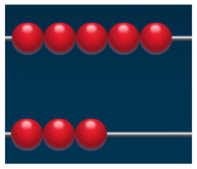

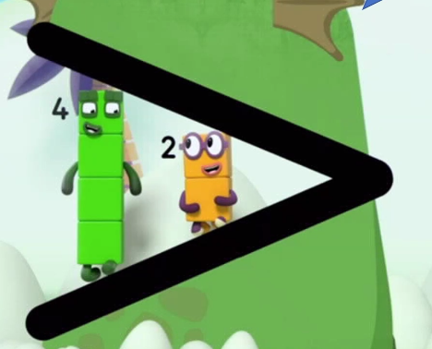
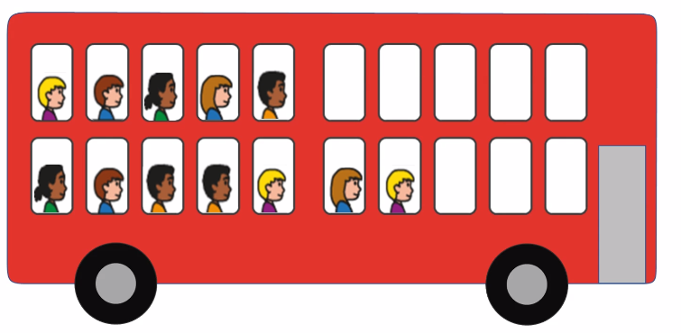
Number Sense

Slide 9


Maths
At home:
Number Bonds and Times Tables
Practise 5 times a week MINIMUM
This can be on Numbots, TT Rockstars or on paper either with an adult/seen by an adult.
Activity must be recorded in home learning record.
This will support their fluency in maths learning at home and give them an extra hour of learning time every week for maths.

Slide 10

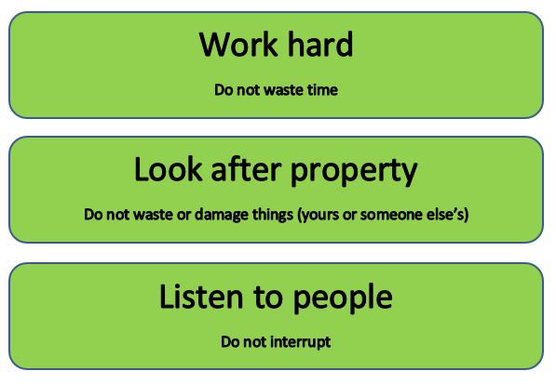
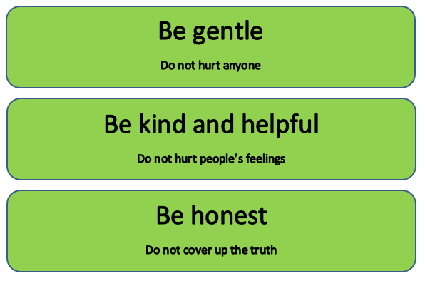
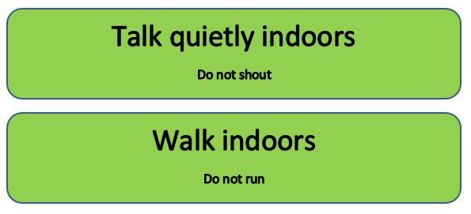
Rules and Expectations
Exceptional behaviour (text sent home)
Behaviour Chart
Shown good behaviour all day
Shown some good behaviour
Well behaved
Verbal warning
2 minutes reflection time
5 minutes reflection time
(text sent home)

Slide 11
Values and Threads
Values:
Ambition
Mindfulness
Honesty
Resilience
Compassion
Thankfulness
Respect
Curiosity
Golden Threads:
Community
Mental Health
Life Skills
Global Issues
Technology

Slide 12





Teaching and Learning
Children need to learn how to learn!
We will be continuing to encourage the children to develop the following skills:
Owl
Strategic Planning
Spider
Links in Learning
Bee
Team Work
Chameleon
Changing Learning
Cat
Curiosity and
Questioning
Unicorn
Creativity
Tortoise
Resilience

Slide 13
Topics
Term 1: What was life like in a castle?
Term 2: Who was Florence Nightingale and why is she important today?
Term 3: Where in the world would you go?
Term 4: What happened during the Great Fire of London?
Term 5: What’s at the bottom of your garden?
Term 6: Do you like to be beside the Seaside?

Slide 14
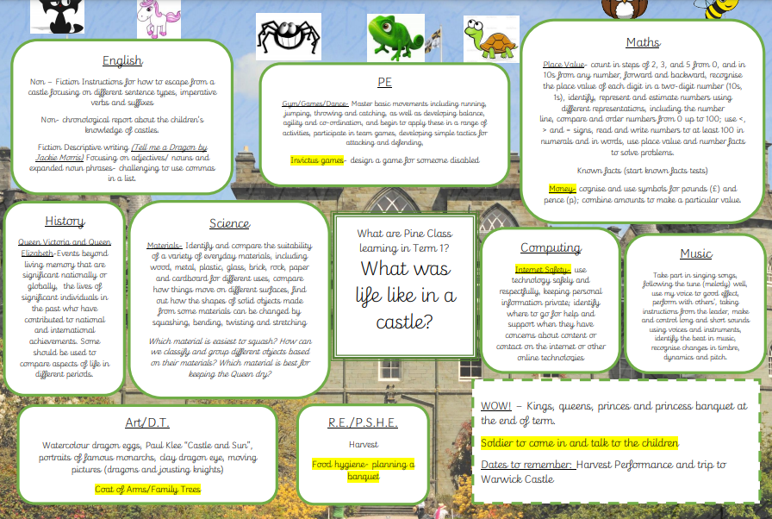
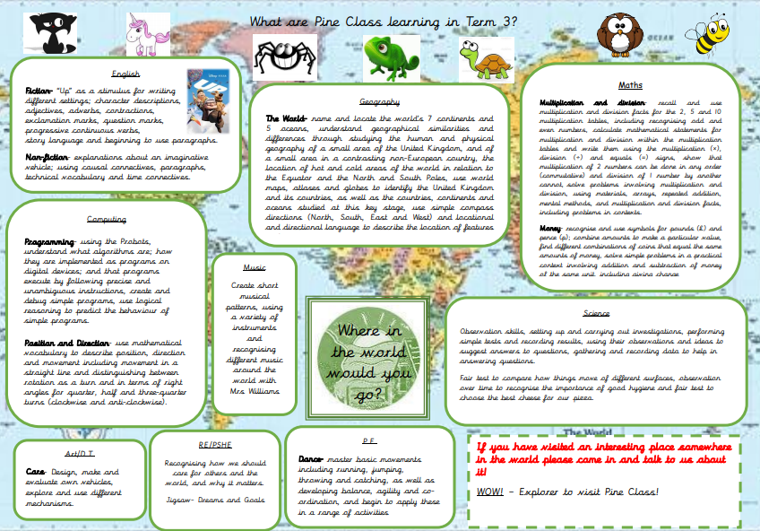
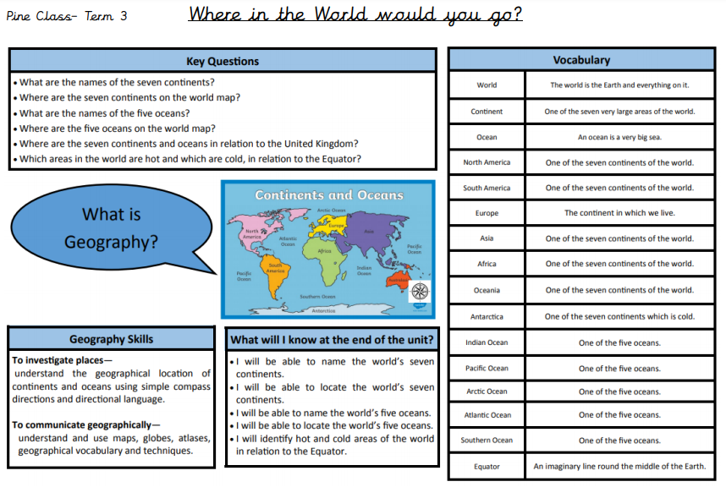
Curriculum Maps and Knowledge Organiser

Slide 15
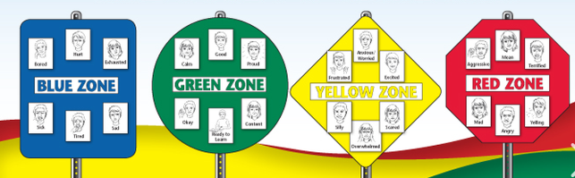
Mental Health and Wellbeing
Golden Thread
Large focus in term 1
Zones of Regulation
Metacognition- learning to learn
Mindfulness
Mental Health Ambassadors
Hello Yellow- watch this space!

Slide 16
Playtime and Lunchtime
Morning Playtime 10:30- 10:45
Children have the choice of a healthy snack or toast and milk if paid for in advance.
Lunchtime 12:15- 1:15
Children go into the hall at 12:15 and eat either packed lunch or hot dinner.
When they finish eating, they go outside and play until 1:15.
Afternoon Playtime 2:30- 2:40
Children are offered fruit or a healthy snack they have brought from home.
Year 2 will join KS2 outside for a playtime.

Slide 17

P.E.
PE is on Tuesday afternoon this term. Every child needs a named PE Kit in School (especially trainers).
P.E. Kit:
1. House colour top and black shorts.
2. White trainers or black daps and socks.
3. Children may wear a jumper and trousers when it is cold/rainy, but these must also be black.

Slide 18

Questions

