Slide 1
Welcome to Holly Class Parent Meeting 2021-22

Slide 2
Holly Class Team
Mrs Wyatt (Mon-Wed) and Ms Fletcher Gardiner
(Thurs & Fri) (class teachers).
Mrs Nelmes (teaching assistant)
Miss Arnold and Mrs Leighton (learning support assistants)

Slide 3
Routines and Timetable

Slide 4
Holly Class Curriculum
The curriculum for reception children is made up of seven areas for Learning and Development. All areas are connected to one another and are equally important.
Personal, social and emotional development
Communication and language
Physical Development
Literacy
Mathematics
Understanding of the world
Expressive Arts and Design

Slide 5
Holly Class Curriculum
Term 1- Getting to know you!
Term 2- Celebrations
Term 3- Cold/Arctic
Term 4- Community Farm/Life Skills
Term 5- Growing
Term 6- Journeys

Slide 6
PSED (Personal, Social, Emotional Development)
Statutory ELG: Managing Self
Be confident to try new activities and show independence, resilience and perseverance in the face of challenge. Explain the reasons for rules, know right from wrong and try to behave accordingly
Statutory ELG: Self Regulation
Set and work towards simple goals, being able to wait for what they want and control their immediate impulses when appropriate. Show an understanding of their own feelings and those of others, and begin to regulate their behaviour accordingly.
Statutory ELG: Building Relationships
Work and play cooperatively and take turns with others; - Form positive attachments to adults and friendships with peers; - Show sensitivity to their own and to others’ needs.

Slide 7
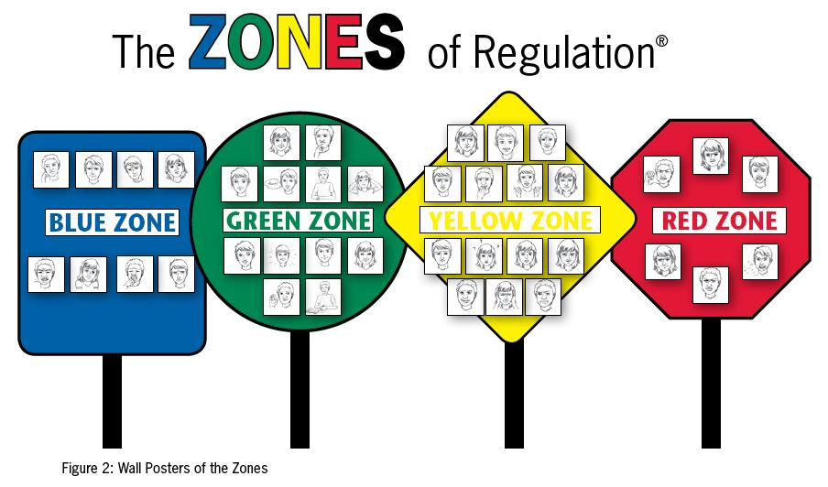
PSED (Personal, Social, Emotional Development)

Slide 8
Focus Children
All children in Holly Class will have regular "Focus Weeks" throughout the year, on a cyclical basis. We will tell you the week before when it is your child's turn and ask for the focus week form back.
We use the Focus Children system to ensure that each child gets an extra special focus at regular intervals, that parents get input into our planning and assessment cycle AND we get to have regular 1:1 meetings with each of you about your child.
This is not to say that when it is not their week we will not be observing, assessing and working closely with them...

Slide 9
Reading/ Writing
How do we teach Reading and Writing in Holly Class?
Adult-led
- Guided reading - Shared stories/ Literacy Input
- Phonics - Story Square time
- Tricky words focus
Child-led
- Being with them in their play, valuing what they do and encouraging use of phonics/ mark making and writing/ design within this play in a purposeful way.
- Ensuring children are independent learners who are able to access phonics resources/ pen grip prompt in their own learning time.

Slide 10
Ways we stay in contact…
Weekly newsletter from Mrs Robinson
Twitter account @HollyClass_RE
Focus children weeks
Email any queries to the office who will forward your message to us enquiries@redfieldedgeprimary.co.uk
Please chat to us at the end of the day!

