Slide 1

Year 6 Parent
Welcome Meeting
Itinerary:
Meet the Team
Routine
Rules and Expectations
Values and Threads
Rules and Expectations
Recovery Curriculum
Mental Health and Wellbeing
COVID Safe
Curriculum Information
Social Media

Slide 2
Meet The Team
Class Teacher
Mr Cadden
Mrs Griffiths
Wednesday afternoon
Mrs Noad
HLTA
Thursday afternoon

Slide 3
Routine
Monday
PE kits for lessons.
Homework Log Book/Reading Record Checked.
Friday:
Homework handed out.
PE kits for lessons.

Slide 4
Rules and Expectations
Philosophy and Ethos
As a caring community, we aim to create an environment which encourages and reinforces good behaviour and the fostering of positive attitudes.
We have high expectations for good behaviour throughout the school and at all times during the school day. This is closely linked to our school’s ethos ‘Striving to Be the Best Version of Ourselves’
The school has a number of rules, but our behaviour policy is not primarily concerned with rule enforcement. It is a means of promoting good relationships, so that people can work together with the common purpose of helping everyone to learn. This policy supports the school community in aiming to allow everyone to work together in an effective and considerate way, whilst keeping children and staff safe at school.

Slide 5
Values and Threads
Values:
Ambition
Mindfulness
Honesty
Resilience
Compassion
Thankfulness
Respect
Curiosity
Golden Threads:
Community
Mental Health
Life Skills
Global Issues
Technology
Notes:
All staff are expected to model these values on a daily basis so the aim is that these ae embedded in the children’s lives. These values become deep-rooted and set the children u fo secondary school and adult life; to be a valued member of society. Values are displayed in the classroom and referred to regularly, assemblies, PSSH, circle time. Link to the golden rules. Golden Threads chosen by staff when redesigning new curriculum as important in today’s society. Children develop these across the curriculum and in their daily school life.

Slide 6

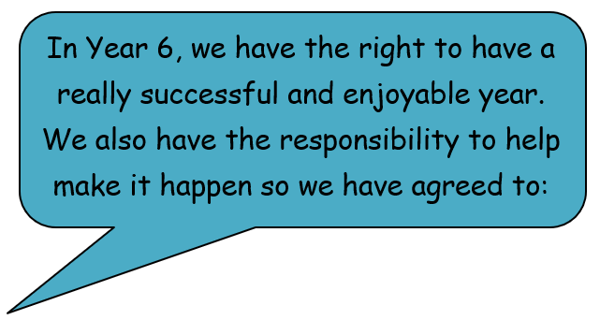
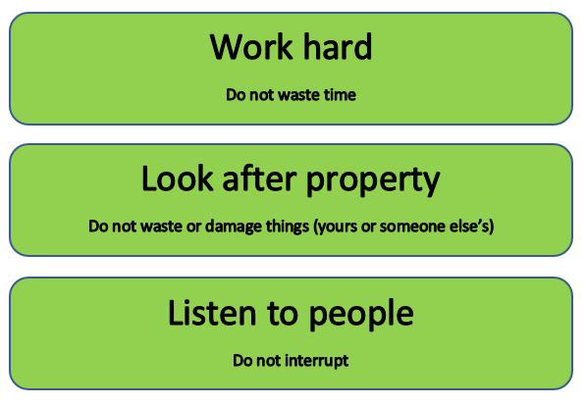
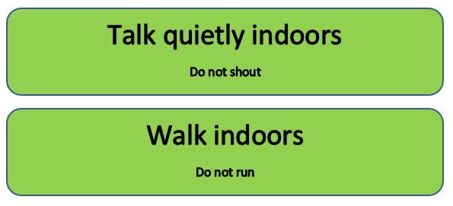
Rules and Expectations
School Rules

Slide 7

Rules and Expectations
Behaviour Chart

Slide 8
Rules and Expectations
Behaviour Chart
Text Message Sent Home
There are many opportunities throughout
The week to impress me by working in
various ways.
Some children are selected to receive a certificate
during celebration assembly on Fridays.

Slide 9
Rules and Expectations
Behaviour Chart
Verbal Warning
Think About It
3 minutes
Consequence
5 minutes
Red Reflection Slip
Contact Home

Slide 10





Teaching and Learning
Children need to learn how to learn!
We will be continuing to encourage the children to develop the following skills:
Owl
Strategic Planning
Spider
Links in Learning
Bee
Team Work
Chameleon
Changing Learning
Cat
Curiosity and
Questioning
Unicorn
Creativity
Tortoise
Resilience

Slide 11
Topics
Term 1: Why was WWII a ‘World War?’
Term 2: Who will make the most profit?
Term 3: What was it like to be alive during the reign of Henry VIII?
Term 4: What is beyond Earth?
Term 5: SATs
Term 6: Let’s Entertain You!

Slide 12
Camp
27th June – 1st July
There will be a meeting about this later in the year.

Slide 13
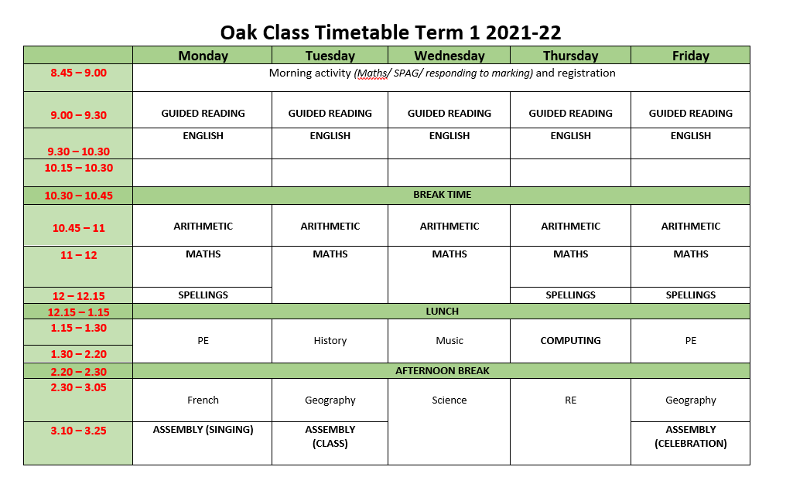
Weekly Timetable
NOTE: This is the current version so it may change throughout the year when topics change and other subjects are taught in the afternoon time.

Slide 14

Twitter
Follow us @OakClass_RE

Slide 15
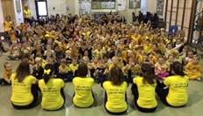
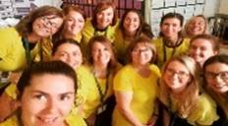
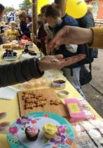
Mental Health and Wellbeing
One of our Golden Threads
We teach:
-Metacognition
-Mindfulness
Year 6 Mental Health Ambassadors
Family Link Worker – Mrs Williams
-Bespoke Support
-1:1 Counselling
-Signposting to outside agency support
Mental Health Team plan events to raise awareness
- Hello Yellow/Fundraisers
- Mental Health Week
- Regular Assemblies
“An anxious child is not a learning child”

Slide 16
COVID Safe
Ongoing procedures in school
Sanitiser available on gates, around school and in classrooms
Children encouraged to wash hands with soap frequently
Children must stay at home and have a test if develop any symptom of COVID-19. This includes a new and persistent cough, a high temperature (typically above 38) and a loss of smell or taste.

Slide 17
Playtime and Lunchtime
Newly implemented procedures in school
Playtime
The children are allowed to mix with children from across the school now. Whole school playtime is 10.30-1045.
Lunchtime
  12:15-13:15 – This is managed by our Pip team
  A large number of Oak class members have volunteered to help with Holly class during lunch. Others are also helping the Pips with anything they may need.

Slide 18

P.E.
PE days are Mondays and Fridays. Every child needs a named PE Kit in School. A soft shell jacket would be a good idea for the rainier months; fashion jackets are not practicle.
P.E. Kit:
1. House colour top and black shorts.
2. White trainers or black daps plimsolls and socks.
3. Children may wear a jumper and trousers when it is cold/rainy, but these must also be black.
Notes:
Swimming

Slide 19
Reading
In school:
Guided reading
VIPERS (please see handout attached)
Focus on comprehension skills gearing up to Reading SATs paper
Library and Reading for Pleasure
The children read independently in class every day as well as listening to our class book read aloud.
They are also given the opportunity to change their book atleast once a week in the library.
ICT Suite – transforming!
Reading Assistant
A select few children will be listened to. These are children who need extra support in reading comprehension

Slide 20
Reading
At home:
Every child should be reading at least 5 times a week at home
Coloured Book Bands
with an adult to be recorded in reading record.
‘Free Reader’
2 times with adult, 3 times independently but still signed by adult.
Children change their books independently and can take books home from class.
They are also allowed to bring home books in, but these must be kept on their desk and not shared with friends at this time.

Slide 21
Maths
In school:
Arithmetic
Taught explicit skill separate from normal maths lessons.
Focus on skills related to SATs Arithmetic Test.
Maths Assistant
A select few children will be taught explicit arithmetic skills in 1:1 sessions. These are children who need extra support in arithmetic.

Slide 22
Maths
At home:
Times Tables
Practise 5 times a week MINIMUM
This can be on TT Rockstars or on paper either with an adult/seen by an adult.
Activity must be recorded in maths record.
Times Tables will be tested in class with the Term 1 & 2 Focus:
Term 1 & 2 – focus on learning all times tables and linking to related facts.
e.g. 7x4 = 28
so 70x4 = 280
and 70x40=2800
And I know that 28 ÷ 4 = 7
so 28 ÷ 7 = 4
and 280 ÷7 = 40

Slide 23
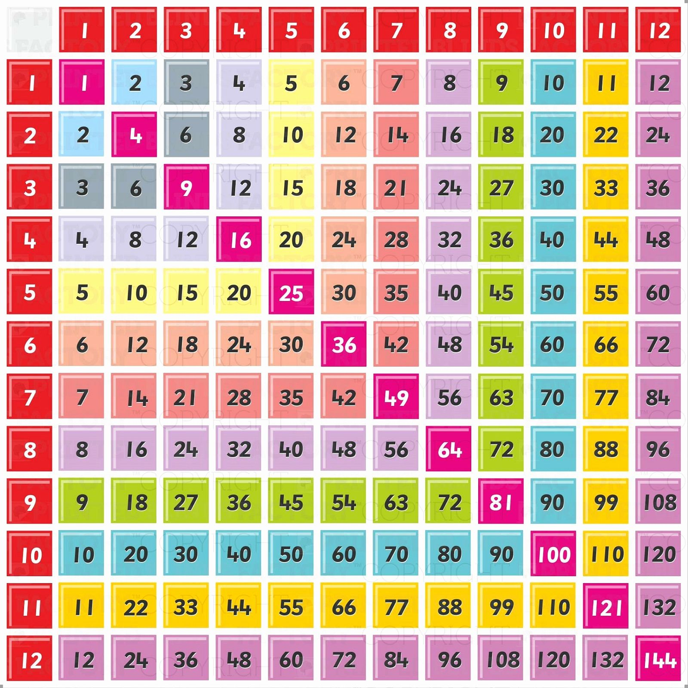
Maths

Slide 24





Social Media
13 years old
16 years old
Check regularly
Take phone off them at night
Screen shot anything worrying
Affects school/friendships massively
If you want to learn more, watch ‘The Social Dilemma’ on Netflix (Certificate 12)

Slide 25
This year will have its challenges, but there are many pleasant thigs to look forward to.
Don’t panic with SATs
There will be a meeting about them closer to the time.

Slide 26
Questions
If you have any more for me over the year, feel free to email the school office and I will get back to you.

